Slide 1
Project 4: - Web application firewall (WAF)
ModSecurity implement On DVWA

Slide 2
Introduction
Name: Noman Ahmed Location:
Quetta, Baluchistan, Pakistan
Background: Bachelor's degree in Information Technology from BUITEMS University with two years of experience in computer networks. Currently, pursuing a cybersecurity course with IEC.

Slide 3
Project Introduction
Objective: Implement an open-source Web Application Firewall (WAF) on a Linux machine and host/implement a web application behind it.
Background: A WAF is designed to protect web applications from various attacks such as SQL injection, cross-site scripting, and more.
Steps:
Select an appropriate open-source WAF such as ModSecurity.
Install the selected WAF on a Linux machine.
Configure the WAF to work with the web application.
Test the WAF by launching an attack on the web application.
Turn on the WAF and demonstrate how it blocks the attack on the web application.
Turn off the WAF and demonstrate how it no longer blocks attacks on the web application.
Discuss the importance of WAFs in protecting web applications from attacks and why it's necessary to have a WAF for any web application.

Slide 4
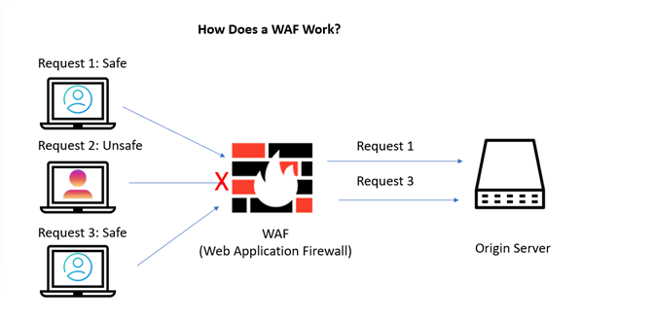
How WAF works

Slide 5
Name of Some WAF
ModSecurity
Cloudflare WAF
F5 Advanced WAF
Akamai Kona Site Defender
Imperva WAF
Barracuda Web Application Firewall
Fortinet FortiWeb

Slide 6

ModSecurity Introducation
ModSecurity is an Apache module for web application protection.
It blocks common attacks, such as SQL injection and cross-site scripting.
ModSecurity has a large set of pre-configured rules.
It is highly customizable for specific web application security needs.
It can be used in conjunction with other security tools.
ModSecurity is backed by the OWASP project.
It supports real-time monitoring and blocking of attacks.
ModSecurity has a learning mode to reduce false positives.

Slide 7
Installation of ModSecurity
Command to install ModSecurity
sudo apt-get install libapache2-mod-security2
sudo a2enmod headers

Slide 8
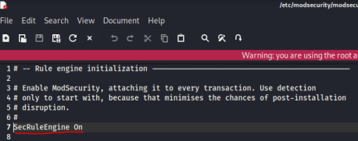
Configuration Of ModSecurity
sudo cp /etc/modsecurity/modsecurity.conf-recommended /etc/modsecurity/modsecurity.conf

Slide 9
Setting Up the OWASP ModSecurity Core Rule Set
sudo rm -rf /usr/share/modsecurity-crs
sudo apt install git
sudo git clone https://github.com/coreruleset/coreruleset /usr/share/modsecurity-crs
sudo mv /usr/share/modsecurity-crs/crs-setup.conf.example /usr/share/modsecurity-crs/crs-setup.conf
sudo mv /usr/share/modsecurity-crs/rules/REQUEST-900-EXCLUSION-RULES-BEFORE-CRS.conf.example /usr/share/modsecurity-crs/rules/REQUEST-900-EXCLUSION-RULES-BEFORE-CRS.conf

Slide 10
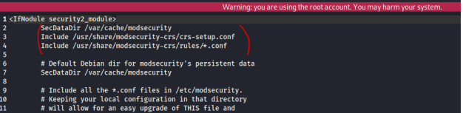
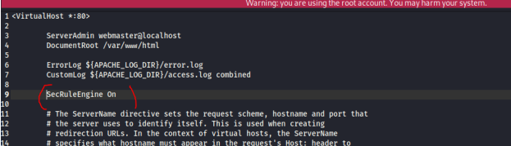
Enabling ModSecurity in Apache 2
/etc/apache2/mods-available/security2.conf
/etc/apache2/sites-enabled/000-default.conf

Slide 11

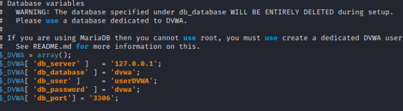
Installation of DVWA on localhost:
cd /var/www/html
sudo git clone https://github.com/ethicalhack3r/DVWA
sudo chmod -R 777 DVWA
cd DVWA/config
sudo cp config.inc.php.dist config.inc.php
sudo nano config.inc.php

Slide 12
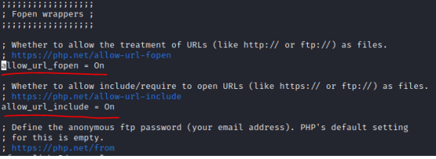
Create database on DVWA localhost
sudo systemctl start mysql
sudo mysql -u root –p
create user 'userDVWA'@'127.0.0.1' identified by "dvwa";
grant all privileges on dvwa.* to 'userDVWA'@'127.0.0.1' identified by 'dvwa';
cd /etc/php/8.1/apache2
sudo nano php.ini
sudo systemctl start apache2

Slide 13
Testing ModSecurity on Localhost
SQL INJECTION
CROSS-SITE SCRIPTING (XSS)
FILE INCLUSION

Slide 14
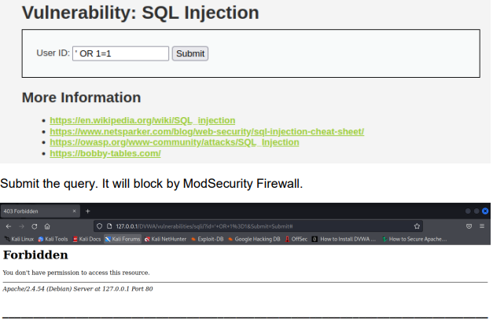
Testing ModSecurity
SQL INJECTION
' OR 1=1 #

Slide 15
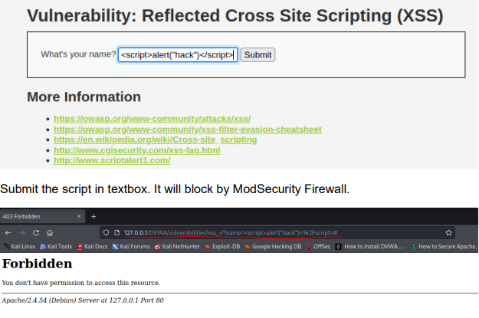
Testing ModSecurity
CROSS-SITE SCRIPTING (XSS)
<script>alert(“Your are hack”) </script>

Slide 16
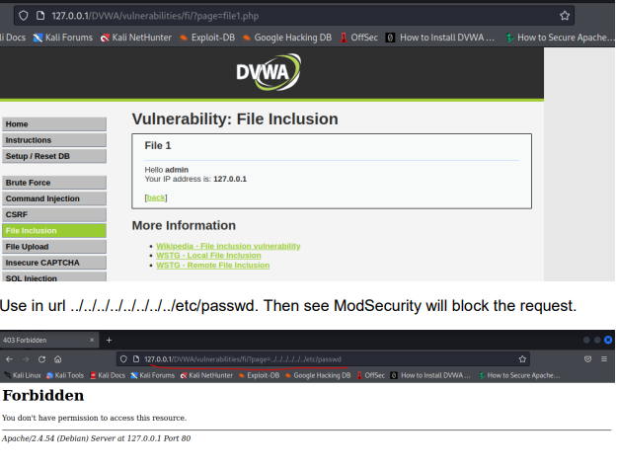
Testing ModSecurity
File INCLUSION
../../../../../../../../etc/passwd

Slide 17
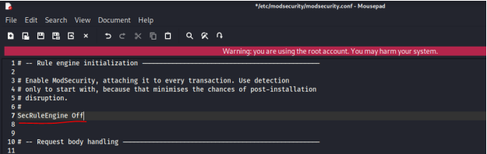
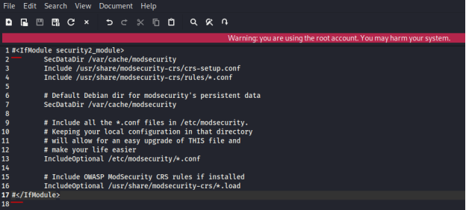
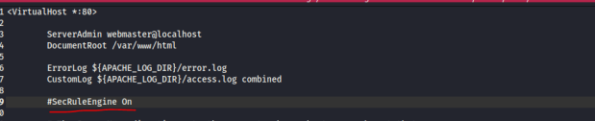
TURN OFF MODSECURITY

Slide 18
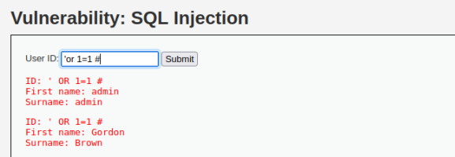
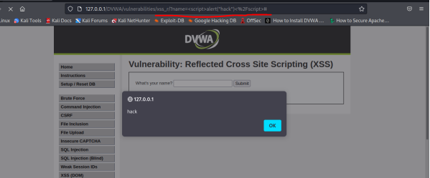
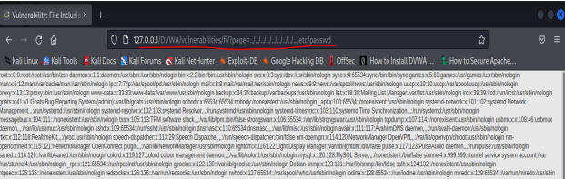
Turn Off ModSecurity Testing

Slide 19
Conclusion
An open-source web application firewall (WAF) can protect web applications from various types of attacks.
ModSecurity can be utilized to prevent SQL injection attacks, Malicious File Upload Attacks, and XSS Attacks.
Implementation of a WAF significantly enhances the security posture of a web application.
Provides an additional layer of defense against attacks that may compromise sensitive data or cause other malicious outcomes.
Web application developers and administrators should consider the implementation of a WAF to safeguard their applications against potential threats.

Slide 20
Thank you for allowing me to assist you. Do you have any other questions?

